Slide 1
Electronic Store Website
Group 8: H2T Group

Slide 2
Need Finding Report
01
02
03
04
About us
Interview
Questionnaire
Conclusion

Slide 3



01
About us
Nguyen T. Thanh Hang
Nguyen Thu Huong
Bui Hanh Trang
20213570
20210423
20210851
A group tending to develop an Electronic Store Website that is friendly to users!

Slide 4
Interview analysis
02
Who?
3 normal users: farmiliar shopping but not highly tech advance feature (office workers, normal students,…)
2 expert users: highly knowledge, experienced (IT major workers, gamer, streamer,…)
1 under extreme user: barely shopping online (older,…)
Why?
Diverse perspectives ➔ be able to make system for various user levels.

Slide 5
Interview analysis
02
What?
Understand users’ behavior, preferences & pain points during shopping
Where?
At HUST Campus
Online via Teams, Messenger, Zalo,…
When?
12, 13/10 or 19, 20/10

Slide 6


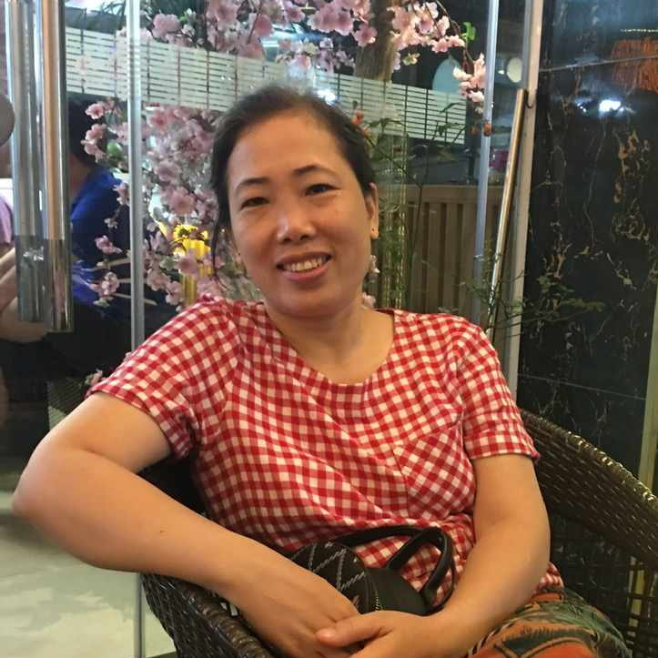
Interviewee – normal users
Do Hong Hanh
Nguyen Thu Hien
Bui Thi Khuong
University student
Highschool student
Office worker
02

Slide 7


Interviewee – expert users
Bui Duc Viet
Nguyen Quy Ngoc
HUST IT student, mostly buys electronic stuffs online
Over extreme user – Job: Streamer
02

Slide 8

Interviewee – extreme user
Nguyen Ba Cau
Under extreme user
02

Slide 9
What did we ask them?
Shopping experience
Website recommendations
Your overall experience in shopping electronic stuffs online?
How would you like to receive recommendations while browsing?
Last time shopping online? What influenced your choices?
Format you prefer when it comes to recommendations?
The helpful of displaying similar devices or products that complement each other when shopping?
Recommendations that focus on similar products or those that suggest upgrades?

Slide 10
What did we ask them?
Feedback & Reviews
Specifics Features & Usability
Do you usually leave reviews or feedback on websites?
Your experience in using product comparison features on the website?
What would motivate you to share your feedback?
Have you encountered any issues or frustrations while navigating the site?
Do you find reviews helpful? How can we improve the usefulness of reviews ?

Slide 11
And how they answered…?

Slide 12

Say
Think
"Sometime the pricing filter is confusing"
"Online shopping often has poor insurance policy"
"I won’t leave bad review, but I would talk about it"
"I like the simple, minimalistic designs"
"Too many tabs were opened when using filters"
"I want to be consulted in real time
"I like the review about the delivery, time, comparing buying offline and online"
A separate section for recommendation would be nice
Confused about the complex filter
Offline shopping to experience at the shop with more reliability.
Doubleful about delivery service
Being careful about pricing and comparison
Won't trust the "sale" review
Trying out shopping online ass a friend recommended
Find it's annoying to create an account for the website
Enjoy the comparison function since it's faster without having to open many tabs
Do
Feel

Slide 13

Say
Think
"Sometime the pricing filter is confusing"
"Online shopping often has poor insurance policy"
"I won’t leave bad review, but I would talk about it"
"I like the simple, minimalistic designs"
"Too many tabs were opened when using filters"
"I like the review about the delivery, time, comparing buying offline and online"
The more simple the better
"I want to be consulted in real time
Highly appreciate reliability
A separate section for recommendation would be nice
Confused about the complex filter
Offline shopping to experience at the shop with more reliability.
Doubtful about delivery service
Being careful about pricing and comparison
Won't trust the "sale" review
Compare carefully
Confuse about technical problems
Trying out shopping online ass a friend recommended
Find it's annoying to create an account for the website
Enjoy the comparison function since it's faster without having to open many tabs
Do
Feel

Slide 14
Language student who prefer simple, interesting design, don't have technical knowledge, strict on the reliability of the purchase, delivery and insurance.
She needs the website enable ability to compare between products, recommendation for general user who don't specialize in tech, fast respond when a question is asked
Insight
Need

Slide 15
Say
Think
"Online products are often more expensive and not as diverse as offline ones"
Discount is a must
I want to know about shipping method and a quality verification from the seller
“Pop up is fine as long as it won’t cover the entire screen”
“I don’t know English, it’d be nice to have Vietnameses option
The products should be divided into price range and shipping area
Image and price of a product is the base of comparison
Like the cheap and well advertised products
Only leave a review when were not satisfy
None of the reviews are trustable
Would find the cheapest product within the needed applications
Make comparision base on color, applications, origin
Would go for a more expensive item if it’s quality is better
There should be information about stocking of every products
Often view the product online and go buy it offline to double check
Do
Feel

Slide 16
Say
Think
"Online products are often more expensive and not as diverse as offline ones"
Need language options
Discount is a must
I want to know about shipping method and a quality verification from the seller
“Pop up is fine as long as it won’t cover the entire screen”
“I don’t know English, it’d be nice to have Vietnameses option
Product filter should contain price and area
The products should be divided into price range and shipping area
Image and price of a product is the base of comparison
Like the cheap and well advertised products
Only use the website for viewing product
Only leave a review when were not satisfy
None of the reviews are trustable
Recommen
-dation by buyer is trustable but the review is not
Don’t make comparison base on technical informations
Would find the cheapest product within the needed applications
Make comparision base on color, applications, origin
Would go for a more expensive item if it’s quality is better
There should be information about stocking of every products
Often view the product online and go buy it offline to double check
Do
Feel

Slide 17
Office worker who highly evaluate services more than appearance, only use the website for viewing and don’t uQnderstand technical properties. She won’t trust review, prefer more recommendation relate to her preferance.
She need filter items by area, stock information in each location, Vietnamese language option.
Insight
Need

Slide 18
Say
Think
“I won’t scroll forever to find the needed product”
“Don’t’ send me mail, I will findyou when I want to buy something”
The quality of products are fine
Will care about application and pricing of a product
“I rarely buy electrical products from online shops”
The pop up recommend
-dations is annoying
“I want who buy this product after me know my thought”
A simple and uncolorful website is boring
Go for the reviews before descriptions and technology informations
The review are important, especially ones with image
The objective view from other buyers are important
Never used comparison features
Would leave a review when extremely satisfied or the oposite
Need the recommendations that expand choice ranges
Do
Feel

Slide 19
Say
Think
“I won’t scroll forever to find the needed product”
A website need to be aesthetically attractive
Pop ups and other notification are not necessary
“Don’t’ send me mail, I will findyou when I want to buy something”
The quality of products are fine
Will care about application and pricing of a product
“I rarely buy electrical products from online shops”
The pop up recommend
-dations is annoying
“I want who buy this product after me know my thought”
A simple and uncolorful website is boring
Go for the reviews before descriptions and technology informations
The review are important, especially ones with image
The objective view from other buyers are important
Read many and would leave important reviews
Online shopping is unrealiable
Never used comparison features
Would leave a review when extremely satisfied or the oposite
Need the recommendations that expand choice ranges
Do
Feel

Slide 20
Highschool student who prefer colorful design, highly rate the reviews with pictures. She don’t like the interruption of ads when browsing and have high doubt whether a costly purchase be successful
She needs detail reviews with pictures, video, … She thinks a beautiful and popular website is better
Insight
Need

Slide 21
Say
"A well-structured, secure checkout is key."
"I expect websites to load fast and be easy to navigate."
Think
"Websites should provide more detailed product specs for tech items."
"Personalized recommendations should feel more accurate, not generic."
"Product recommendat-ions should be relevant and personalized."
"Good design and usability are just as important as the products."
"Spam reviews lower trust in the site."
"I want detailed product descriptions, especially for tech."
"I leave reviews to help others and value a clear, organized review system."
"A clear refund/return policy is essential for trust."
"If the mobile experience is bad, I’m less likely to buy."
"UI/UX consistency across devices is a must."
Appreciates smart, intuitive design that improves shopping.
Avoids websites with too many pop-ups or intrusive ads.
Annoyed by slow or clunky websites, especially on mobile.
Checks security certificates and data privacy policies before purchasing.
Trusts sites that feel secure and are transparent about privacy.
Writes detailed reviews about user experience, not just the product.
Feels confident buying from a website with a solid reputation.
Feels more loyal to brands that actively listen to customer feedback.
Tests the website’s speed and responsiveness on different devices.
Frustrated when filtering options don’t work properly or are too limited.
Pays attention to the accuracy of recommendations, tracking how they change with browsing.
Uses advanced filters and comparisons for both prices and specs.
Do
Feel

Slide 22
Say
"A well-structured, secure checkout is key."
"I expect websites to load fast and be easy to navigate."
Think
"Websites should provide more detailed product specs for tech items."
"Personalized recommendations should feel more accurate, not generic."
Good design is as important as product quality.
"Product recommendat-ions should be relevant and personalized."
Want clear and relevant product recommenda-tions.
"Good design and usability are just as important as the products."
"Spam reviews lower trust in the site."
Expect fast and secure websites.
Spam reviews lower trust.
"I want detailed product descriptions, especially for tech."
"I leave reviews to help others and value a clear, organized review system."
"A clear refund/return policy is essential for trust."
"If the mobile experience is bad, I’m less likely to buy."
"UI/UX consistency across devices is a must."
Appreciates smart, intuitive design that improves shopping.
Avoids websites with too many pop-ups or intrusive ads.
Annoyed by slow or clunky websites, especially on mobile.
Checks security certificates and data privacy policies before purchasing.
Trusts sites that feel secure and are transparent about privacy.
Writes detailed reviews about user experience, not just the product.
Reviews product and user experience.
Strict on the friendliness of the website
Compares products using filters and specs.
Feels confident buying from a website with a solid reputation.
Feels more loyal to brands that actively listen to customer feedback.
Tests the website’s speed and responsiveness on different devices.
Frustrated when filtering options don’t work properly or are too limited.
Pays attention to the accuracy of recommendations, tracking how they change with browsing.
Uses advanced filters and comparisons for both prices and specs.
Do
Feel

Slide 23
IT students who design websites are more satisfied when he can work with well-structured, efficient systems that showcase clear, user-friendly interfaces, rather than just focusing on technical performance alone.
He needs tools that help to combine technical accuracy with user-focused design to create smooth browsing experiences for end users.
Insight
Need

Slide 24
Say
Think
“I’ve bought lots of electronics online: headphones, mice, USB drives, power banks, keyboards, etc”
“I usually rely on the website’s recommendations, reviews, or sometimes even ask ChatGPT.”
"Recommendations are helpful, but I prefer similar products within my price range rather than upgrades."
"I’m cautious about overly positive or mechanical reviews. Some reviews aren’t trustworthy."
"The recommended products are quite relevant to my needs."
"There should be more detailed information about the product in the first images or descriptions on product pages."
“I usually rely on the website’s recommendations, reviews, or sometimes even ask ChatGPT.”
"Product comparisons help, especially when deciding between price, performance, and design."
"The interface was okay, user-friendly, and pretty easy to use."
"I use product filters to search within my budget and by location for faster delivery."
"I felt comfortable navigating the site, but sometimes it felt frustrating when search results weren’t accurate."
"I only leave reviews if the product is exceptional or if I feel there’s not enough feedback from others."
"Reviews are helpful, but spam or non-constructive reviews affect my trust in them."
"I often rely on the ‘Recommended for You’ section or browse suggested products via emails."
"I feel the recommendations are impressive, but I don’t always make a purchase."
"I don’t feel the recommendation system invades my privacy because the suggestions aren’t too personal."
"I’ve used comparison features to decide between similar products based on performance and price."
Do
Feel

Slide 25
Say
Think
“I’ve bought lots of electronics online: headphones, mice, USB drives, power banks, keyboards, etc”
“I usually rely on the website’s recommendations, reviews, or sometimes even ask ChatGPT.”
"Recommendations are helpful, but I prefer similar products within my price range rather than upgrades."
frequently buys electronics online, relying on website recommendations and reviews, and finds the interface easy to navigate.
"I’m cautious about overly positive or mechanical reviews. Some reviews aren’t trustworthy."
cautious about the authenticity of reviews and prefers detailed product information upfront, especially for making budget-conscious decisions.
"The recommended products are quite relevant to my needs."
"There should be more detailed information about the product in the first images or descriptions on product pages."
“I usually rely on the website’s recommendations, reviews, or sometimes even ask ChatGPT.”
"Product comparisons help, especially when deciding between price, performance, and design."
"The interface was okay, user-friendly, and pretty easy to use."
"I use product filters to search within my budget and by location for faster delivery."
"I felt comfortable navigating the site, but sometimes it felt frustrating when search results weren’t accurate."
actively uses filters and comparison tools, but only leaves reviews for exceptional products or when feedback is lacking.
"I only leave reviews if the product is exceptional or if I feel there’s not enough feedback from others."
feels comfortable with recommendation systems as long as they respect her privacy and provide useful, relevant suggestions.
"I often rely on the ‘Recommended for You’ section or browse suggested products via emails."
"Reviews are helpful, but spam or non-constructive reviews affect my trust in them."
"I feel the recommendations are impressive, but I don’t always make a purchase."
"I don’t feel the recommendation system invades my privacy because the suggestions aren’t too personal."
"I’ve used comparison features to decide between similar products based on performance and price."
Do
Feel

Slide 26
Ngoc values efficient and trustworthy recommendations, but he is cautious about the authenticity of reviews. He wants accurate product information and streamlined navigation for quick decision-making.
He needs clearer, more detailed product descriptions upfront, reliable review systems, and relevant recommendations that align with his budget and preferences. Additionally, enhancing the search accuracy and product diversity would improve his shopping experience.
Insight
Need

Slide 27

Say
"I don't buy electronics online, I go to stores for advice and to check products."
Think
"Keep recommend-ations in a corner, not pop-ups."
“Buying things online is risky; it’s hard to trust websites completely.”
“What if I click on a link, and it downloads a virus to my device?”
“If I can't see the product firsthand, how will I know if it’s good?”
"Similar products are easier to understand than upgrades."
"I share product experiences with relatives, not online."
“Upgrades might be too complicated, so I’ll need to ask my kids before buying.”
Finds value in using price filters when others shop for him.
Worries about making the wrong purchase decision online.
Wants to ensure others make informed decisions by sharing personal recommendations offline.
Prefers to receive product recommendations from store staff.
Avoids clicking on unknown links to prevent viruses or issues with his phone.
Annoyed by ads that redirect to different pages and slow down the phone with unnecessary downloads.
Feels safer shopping at physical stores where products can be inspected.
Relies on family or friends for help with online shopping.
Do
Feel

Slide 28
Say
"I don't buy electronics online, I go to stores for advice and to check products."
Think
Online shopping feels risky due to lack of firsthand inspection.
"Keep recommend-ations in a corner, not pop-ups."
“What if I click on a link, and it downloads a virus to my device?”
Prefers physical stores for better advice and product inspection.
“Buying things online is risky; it’s hard to trust websites completely.”
“If I can't see the product firsthand, how will I know if it’s good?”
"Similar products are easier to understand than upgrades."
"I share product experiences with relatives, not online."
“Upgrades might be too complicated, so I’ll need to ask my kids before buying.”
Finds value in using price filters when others shop for him.
Worries about making the wrong purchase decision online.
Wants to ensure others make informed decisions by sharing personal recommendations offline.
Relies on family for online purchases and uses price filters for deals.
Prefers to receive product recommendations from store staff.
Avoids clicking on unknown links to prevent viruses or issues with his phone.
Frustrated by disruptive ads and accidental downloads.
Shares product-using experiences with relatives.
Annoyed by ads that redirect to different pages and slow down the phone with unnecessary downloads.
Feels safer shopping at physical stores where products can be inspected.
Relies on family or friends for help with online shopping.
Do
Feel

Slide 29
Older adults prefer physical shopping experiences, his distrust in online platforms stems from concerns about misleading ads, potential scams, and disruptive browsing experiences.
He needs ad-free, simple, and secure online platforms that provide clear product reliability of a website, he would be more willing to try online shopping on his own.
Insight
Need

Slide 30
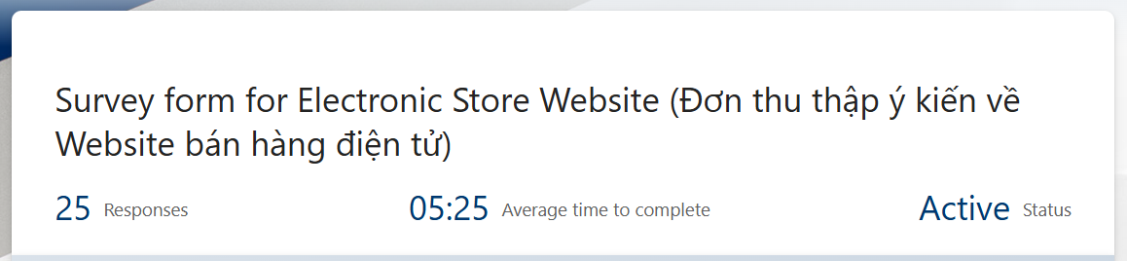
Questionnaire responses
03

Slide 31
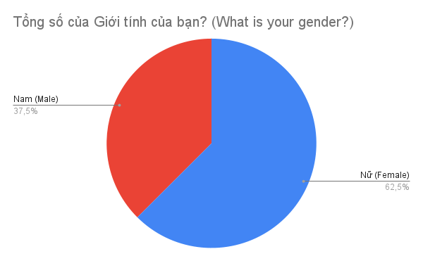
What is your gender?
03

Slide 32
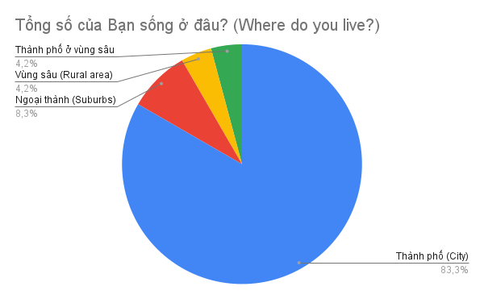
Where do you live?
03

Slide 33
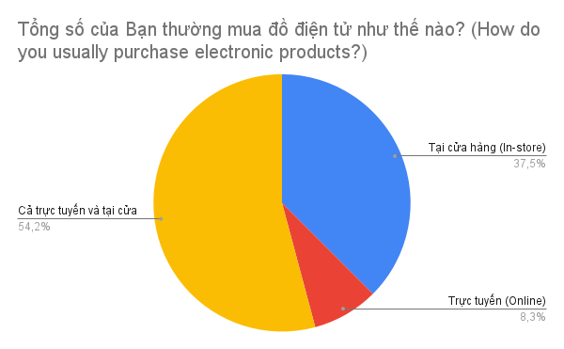
Where do you buy it?
03

Slide 34
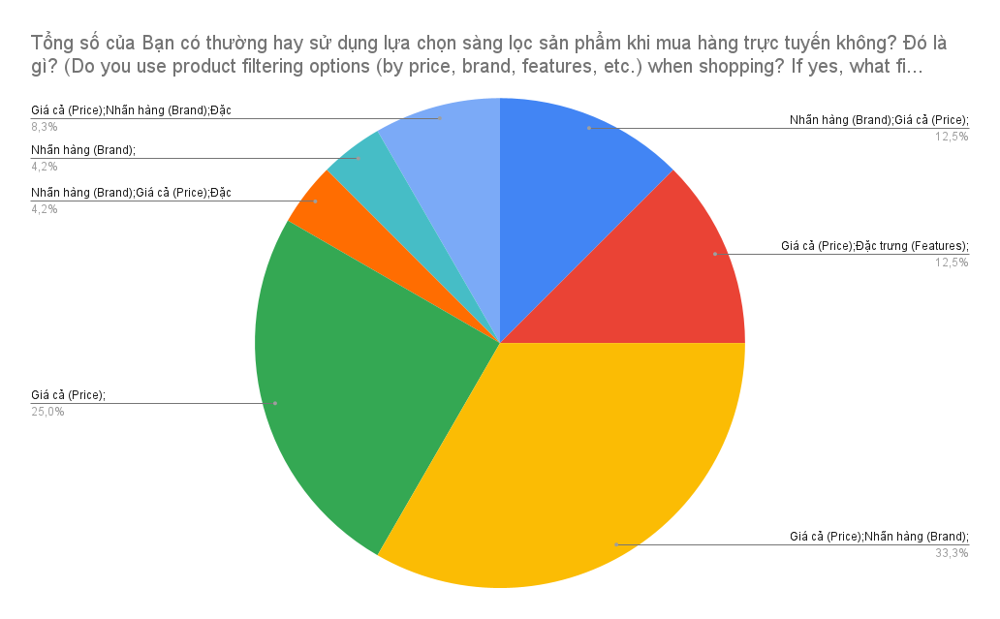
Chart showing web filtering usage trends
03

Slide 35
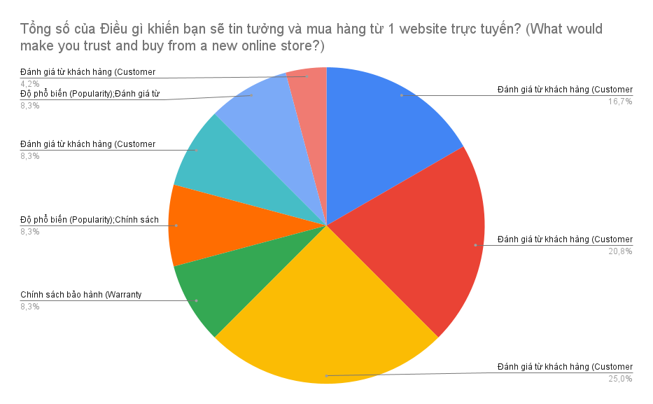
Chart about the truth of buying things
03

Slide 36
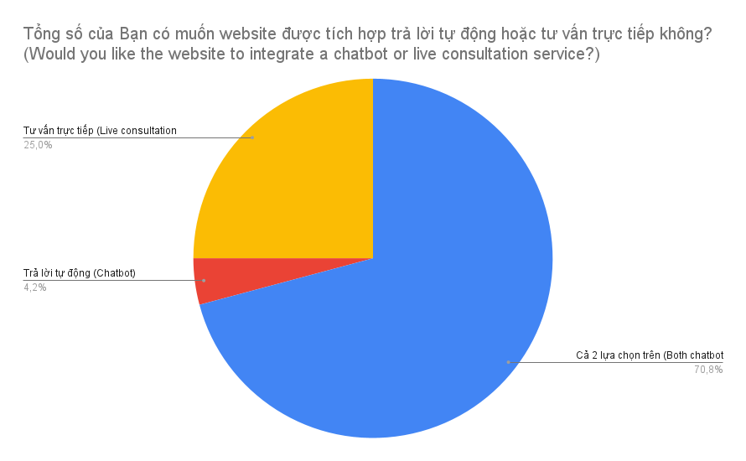
Chart about recommendation function
03

Slide 37
Needs assessment
Friendly interface
Filter and recommendations
Users prefer simple design with as less pop up ads as possible
Users want general and personal recommendations without specific filter on technical information
Reliability
Reviews
Users often need insurance about product's quality
Users find spam reviews for sale are annoying, they want detail and authentic experience from other buyers

Slide 38
Thanks!
Does anyone have any questions?

